Slide 1
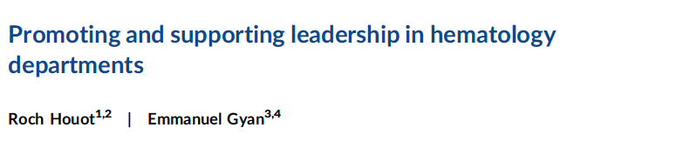
Nouvelles de l’Europe/EHA en 3 points
1 Suite journée SFH 2024, 2 Reconnaissance de notre discipline, 3 Reglémentaire
6 Février 2025, Elizabeth Macintyre, past president EHA, president BioMed Alliance in Europe
Houot, R., & Gyan, E. (2024). HemaSphere, 8(10), e70028. https://doi.org/10.1002/hem3.70028

Slide 2
2 Reconnaissance européenne de l’hematologie
Rencontre MESR, DGESIP, SFH et EHA 19/9/24
Direction Générale de l’Enseignement Supérieure et de l’Insertion Professionnelle
Oriane Wagner-Ballon
Thierry Facon, Marc Maynadié,
Elizabeth Macintyre, Antonio Almeida, Président EHA

Slide 3
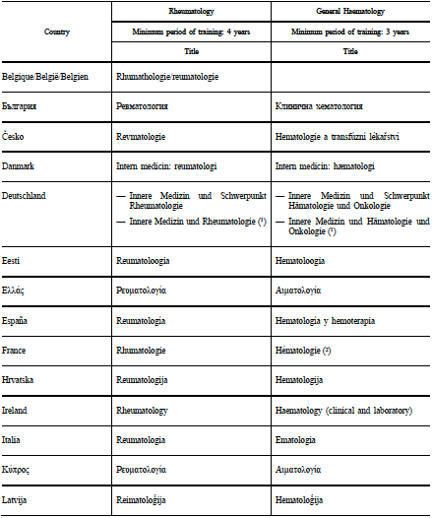
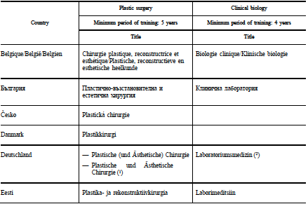
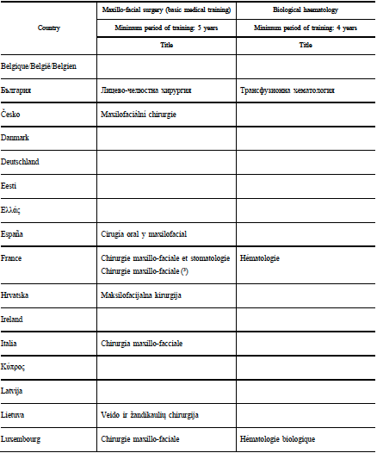
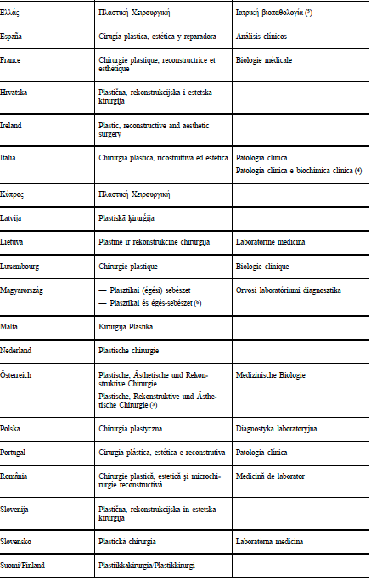
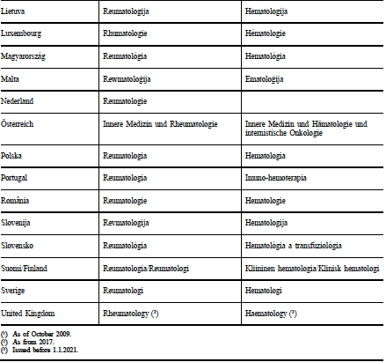
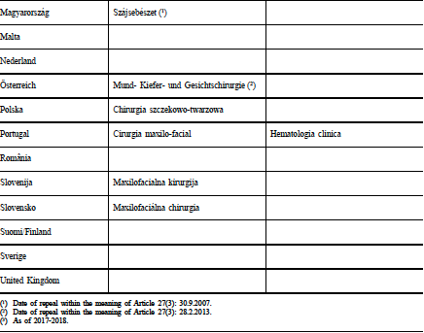
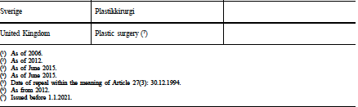
Hematology specialist recognition
in the EU:
Updated Annexe 5 of the
Professional qualifications Directive 2005/36/EC2006
28 countries –
at June 2024
General Hematology
26/28, 93%
Biological Hematology
4/28 14%
Clinical Biology
16/28 57%

Slide 4

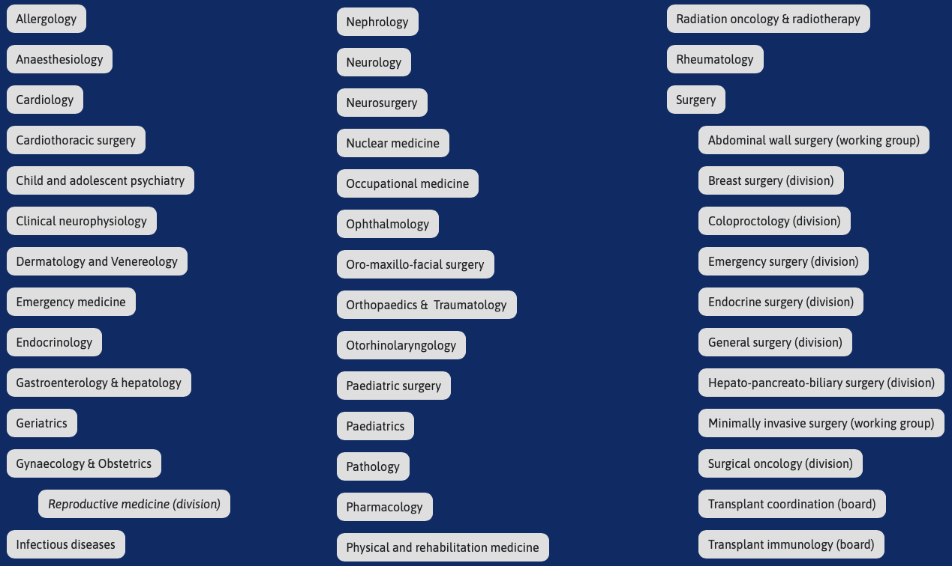
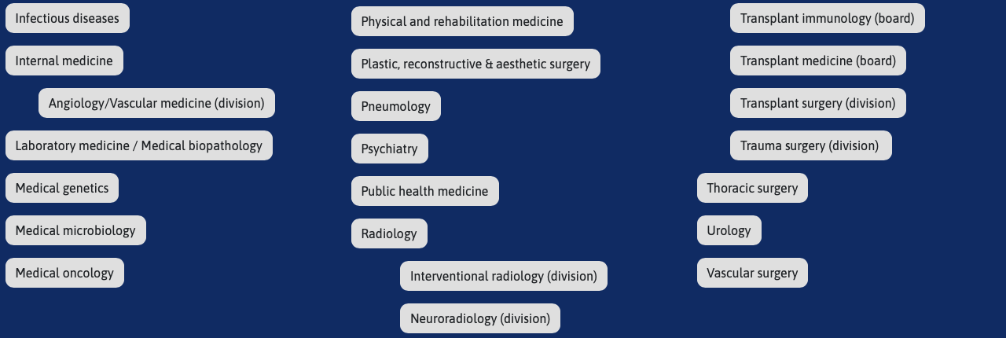
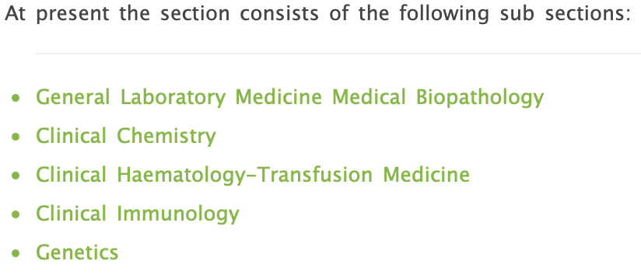
43 Specialties sections
Recognised by the EU
Represent and promote their specialty
Develop European standards of medical training and criteria of recognition
Composed of national representatives
Can set up European Boards dedicated to scientific and training interests of the specialty
A UEMS specialist section may create one or more divisions under its responsibility, devoted to the study, promotion and defence of a branch of the specialty or competence

Slide 5
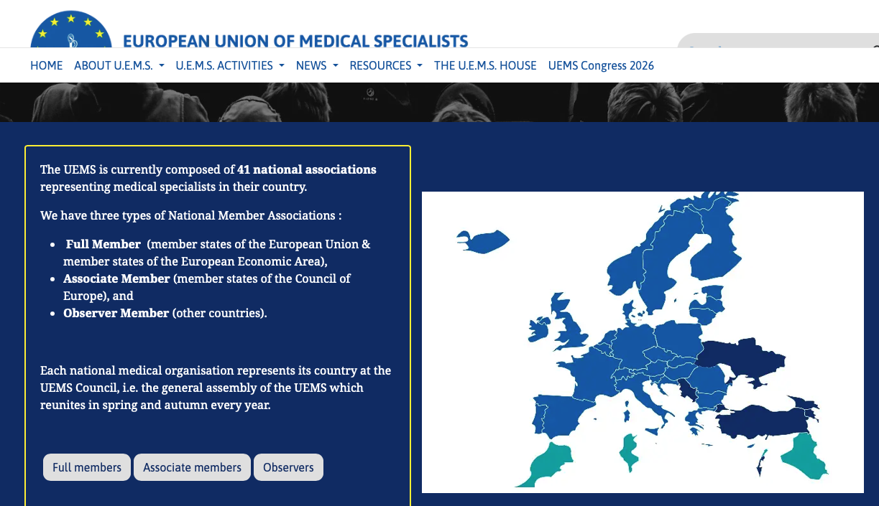

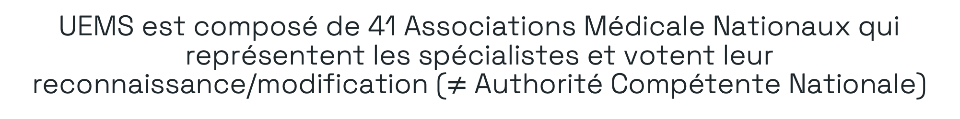
UEMS est composé de 41 Associations Médicale Nationaux qui représentent les spécialistes et votent leur reconnaissance/modification ($≠$ Authorité Compétente Nationale)

Slide 6



































3 Reglémentaire

Slide 7

Strategic approach
Improving health research
Towards a harmonised regulatory system
Other common matters for our members
Education
We work to improve biomedical research and healthcare in several ways:
  Better funding and better coordination of health research
  Work together towards a harmonised regulatory system which supports research and better health in Europe
  Support our members in other common matters
  Strengthening Education

Slide 8


Examples of Policy files
European Health Data Space (EHDS)
Medical Devices Regulation (MDR) / In Vitro Diagnostics Regulation (IVDR)
Health Technology Assessment Regulation (HTA)

Slide 9
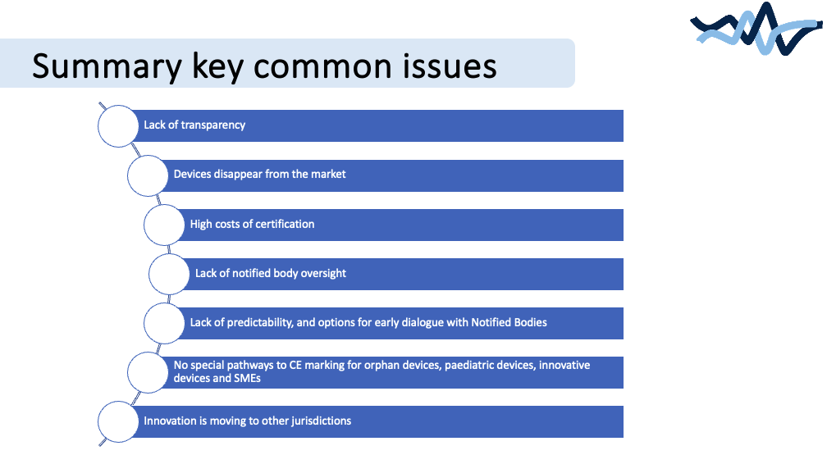

Slide 10

Targeted evaluation of the MDR & IVDR
Public consultation carried out by the Commission to assess the current EU rules on medical devices and in vitro diagnostic medical devices.
Consists of:
  public consultation (questionnaire)
  call for evidence
Feedback open until 21 March

Slide 11
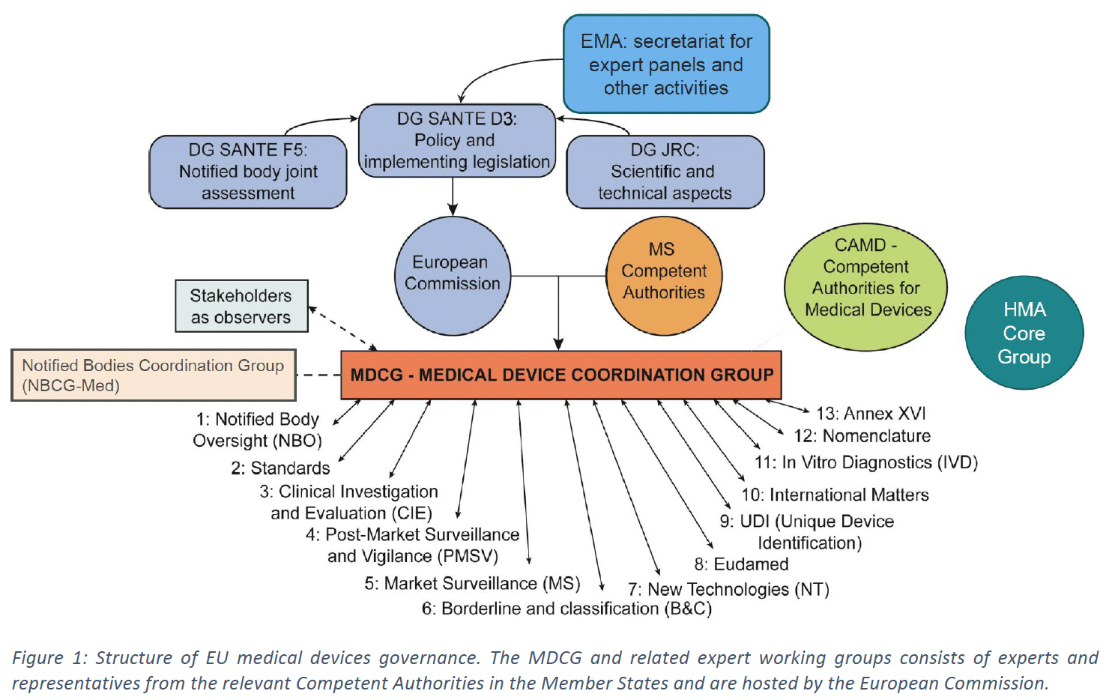
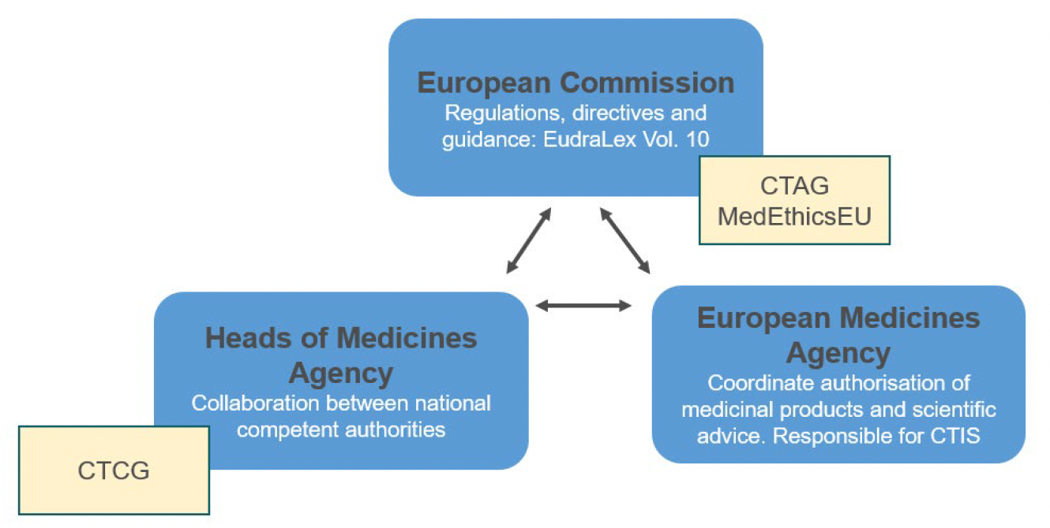
3 Reglémentaire et gouvernance,
MDR/IVDR + CTR = COMBINE
ANSM
coordination
https://health.ec.europa.eu/medical-devices-topics-interest/combined-studies_en
MD/IVD (CMDRH) et médicaments sous l’égide de la FDA aux USA
Medical Device Regulations (MDR) and IVD Regulations (IVDR) since 2017

Slide 12
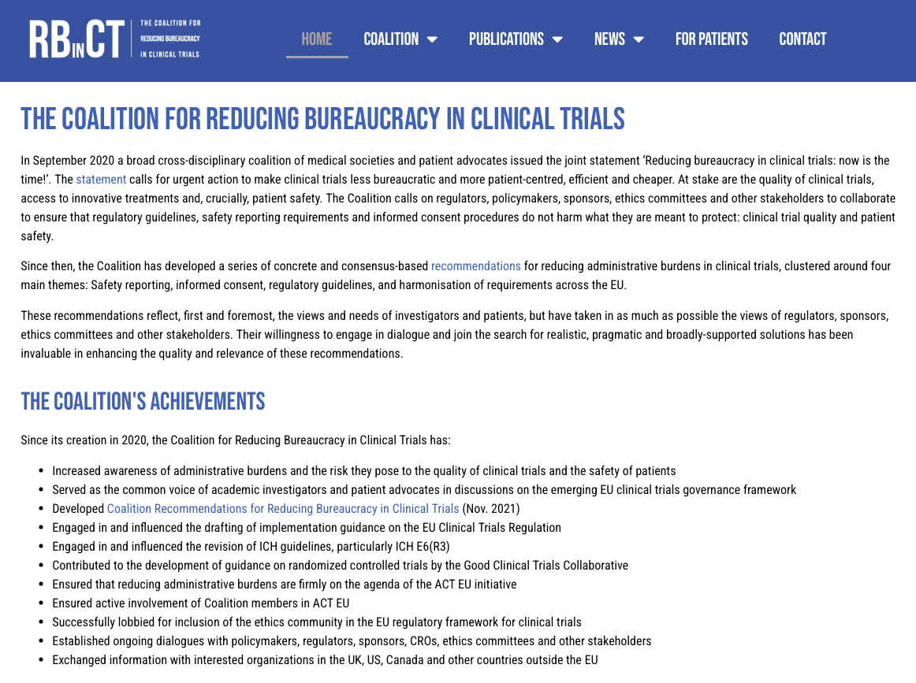
https://bureaucracyincts.eu

Slide 13
